Slide 1

Bitcoin Market Analysis
Data Analytics Project
Presented by : Yasmeen Abdelhamid- Rewaa Mostafa – Samira Samir – Sama Mohamed
Date :
Supervised by : Eng. Mohamed AlEmam

Slide 2

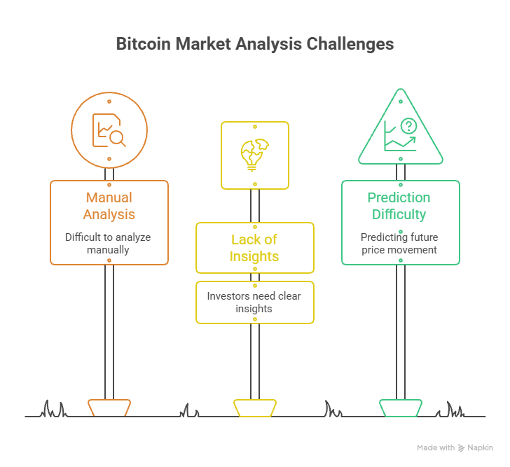


Problem ●Bitcoin generates massive trading data every minute. ●Raw market data is difficult to analyze manually. ●Investors need clear insights to understand market behavior. ●Predicting future price movement remains a challenging task. Solution ●Build a complete Data Engineering pipeline. ●Apply Medallion Architecture (Bronze, Silver, Gold). ●Create a Data Warehouse using Star Schema. ●Develop interactive Power BI dashboards. ●Build a Machine Learning model to predict future market direction. Unique Value ●End-to-end analytical pipeline. ●Engineered financial indicators. ●Interactive dashboards. ●Machine Learning prediction. ●Decision support for Bitcoin market analysis.

Slide 3
Dashboard Overview Project Wireframe — Power BI Dashboard 01 Market Overview High-level Bitcoin market summary ●Price Overview ●Volume Spikes ●Volatility Range ●Capital Flow 02 Buyer VS Seller Pressure ●Buy VS Sell pressure ●Net Order Flow ●Overheating Watch 03 Liquidity , Support & Resistance ●Price Rejection ●Support Strength ●Consolidation Range

Slide 4
Cont. Dashboard Overview Project Wireframe — Power BI Dashboard 04 Trend and Breakout Tracking ●Trend Strength VS Volume ●Trend Persistence ●Breakout & Compression Watch ●Breakout Status 05 Trader Activity & Whale Watch ●Trade Participation ●Whale Watch ●Trade Intensity ●Volatility Clusters 06 The Forecast ●Predictions By Timeframe ●Confusion Matrix ●Confidence Score ●Feature Importance

Slide 5
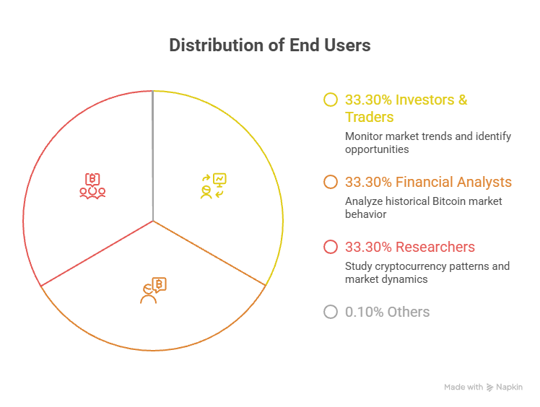
End Users + Features
End Users :
Investors & Traders : Monitor market trends and identify trading opportunities.
Financial Analysts : Analyze historical Bitcoin market behavior.
Researchers :Study cryptocurrency patterns and market dynamics.
Key Features :
✔ Medallion Architecture
✔ Data Warehouse (Star Schema)
✔ Feature Engineering
✔ Interactive Power BI Dashboard
✔ Machine Learning Prediction
✔ Future Price Forecast

Slide 6
Data Structure
Dataset Overview
Source : Kaggle — Bitcoin Historical Dataset
Period : 2018 – 2025
Timeframes :
●15 Minutes
●1 Hour
●4 Hours
●1 Day
Raw Data
●Open
●High
●Low
●Close
●Volume
●Number of Trades

Slide 7
Cont. Data Structure
- Engineered Features :
●Price Change
●Return Percentage
●Volatility
●Trend Strength
●Buy Ratio
●Order Flow
●Whale Activity
●Breakout
●Support & Resistance
Medallion Architecture :
Bronze
↓
Silver
↓
Gold
↓
Power BI + Machine Learning

Slide 8



Programming Languages & Tools
- Programming Languages : Python
- Libraries :
●Pandas
●NumPy
●Matplotlib
●Seaborn
●Scikit-learn
Visualization : Power BI
Development : Visual Studio Code
Dataset : Kaggle
Storage :
●CSV Files
●Star Schema

Slide 9
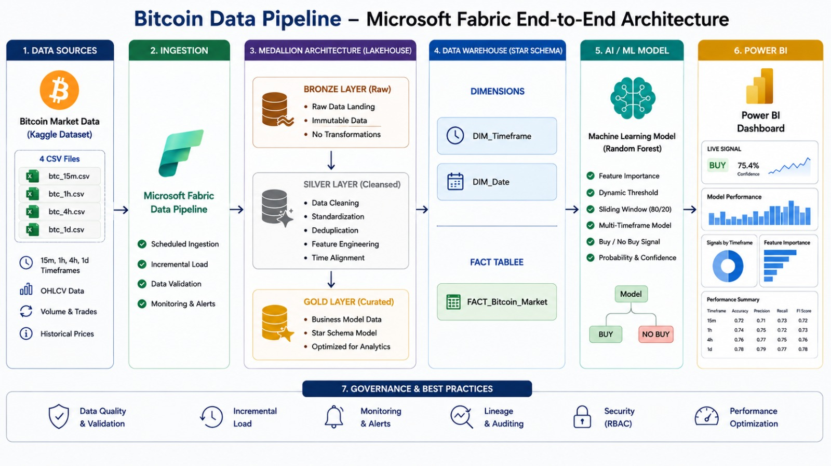
Live Application
Project Status
Data Pipeline Completed
Feature Engineering Completed
Data Warehouse Completed
Power BI Dashboard Completed
Machine Learning Model Completed

Slide 10
Deliverables
01 Data Pipeline :
●Bronze Layer— Raw data (391510 rows, 12 cols)
●Silver Layer— Cleaned data (391385 rows, 35 cols)
●Gold Layer— Delta Star Schema (1 fact + 2 dims)
02 Power BI Dashboard :
● 6-Page Interactive Dashboard
●KPI Cards
●Charts
●Slicers
03 Machine Learning :
●Predictions By Timeframe ●Confusion Matrix ●Confidence Score ●Feature Importance
04 Documentation
●Project Documentation
●Source Code
● Presentation

Slide 11

Project Wireframe :
Power BI Dashboard : Landing page :

Slide 12
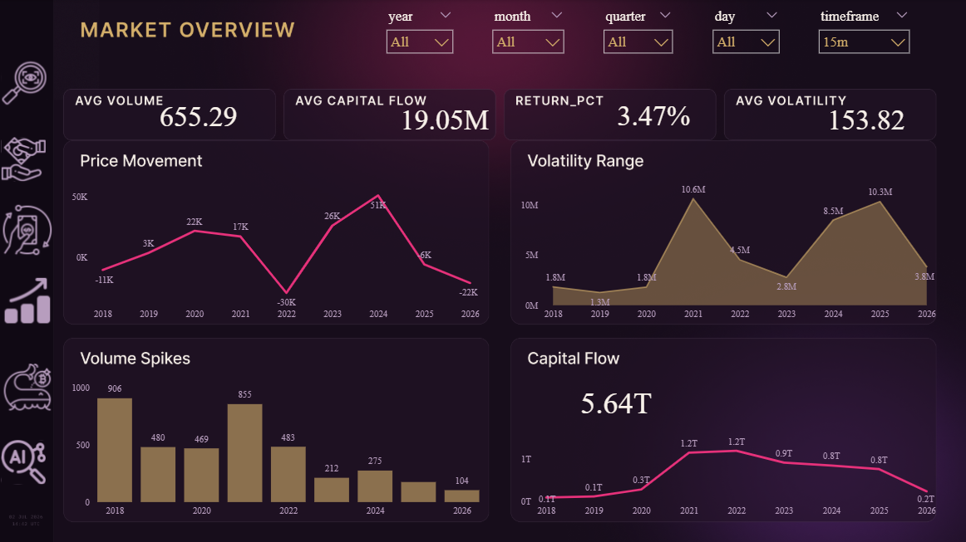

Project Wireframe :
Power BI Dashboard : Page 1- Market Overview:
Market Overview :
This dashboard provides a high-level overview of Bitcoin market performance, helping users monitor price movement, trading activity, and market trends in one place.

Slide 13
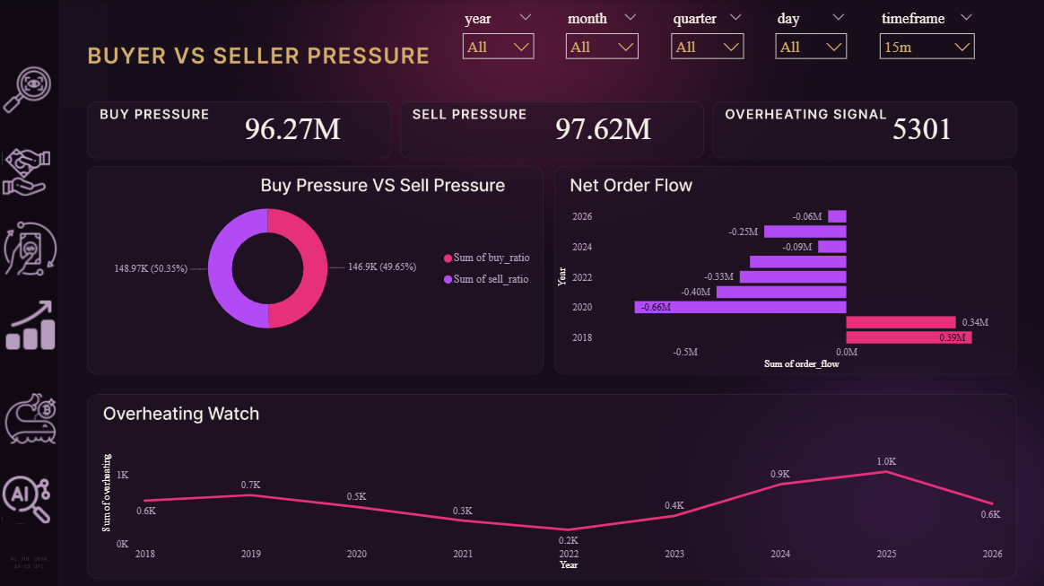
Project Wireframe :
Power BI Dashboard : Page 2- Buyer VS Seller Pressure :
Buyer VS Seller Pressure :
This dashboard tracks the balance of power between buyers and sellers in the Bitcoin market, helping users spot shifts in order flow and detect overheating conditions before they turn into reversals.

Slide 14
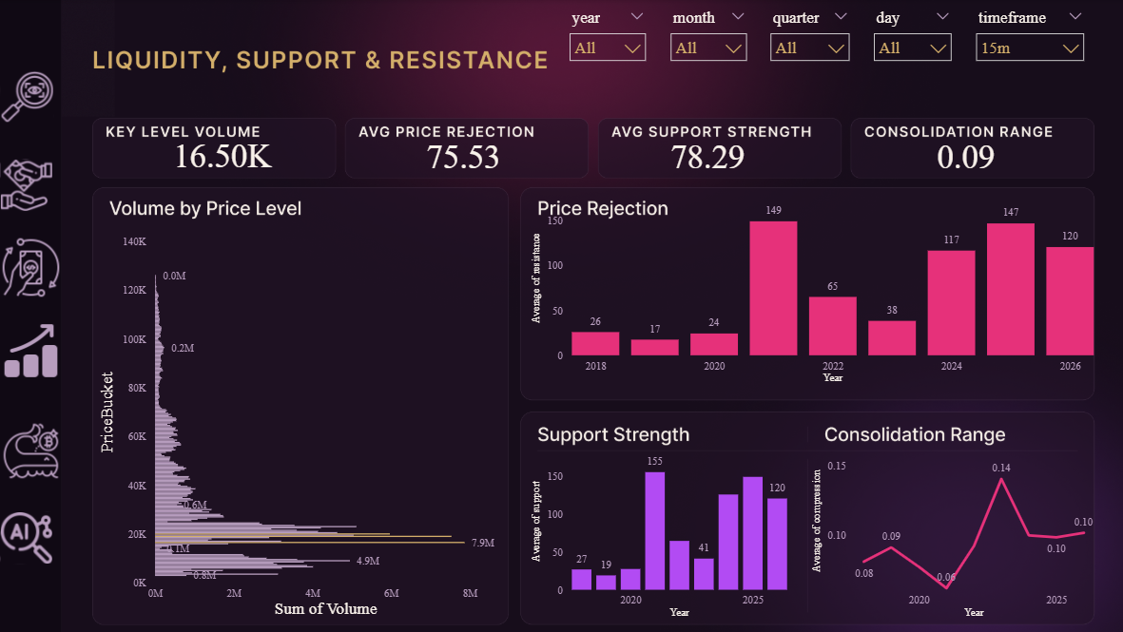
Project Wireframe :
Power BI Dashboard : Page 3- Liquidity,Support & Resistance:
Liquidity, Support & Resistance:
This dashboard maps out where Bitcoin's trading volume concentrates by price level and how strongly price rejects or holds at key zones, helping users spot support, resistance, and consolidation before the market breaks in a new direction.

Slide 15
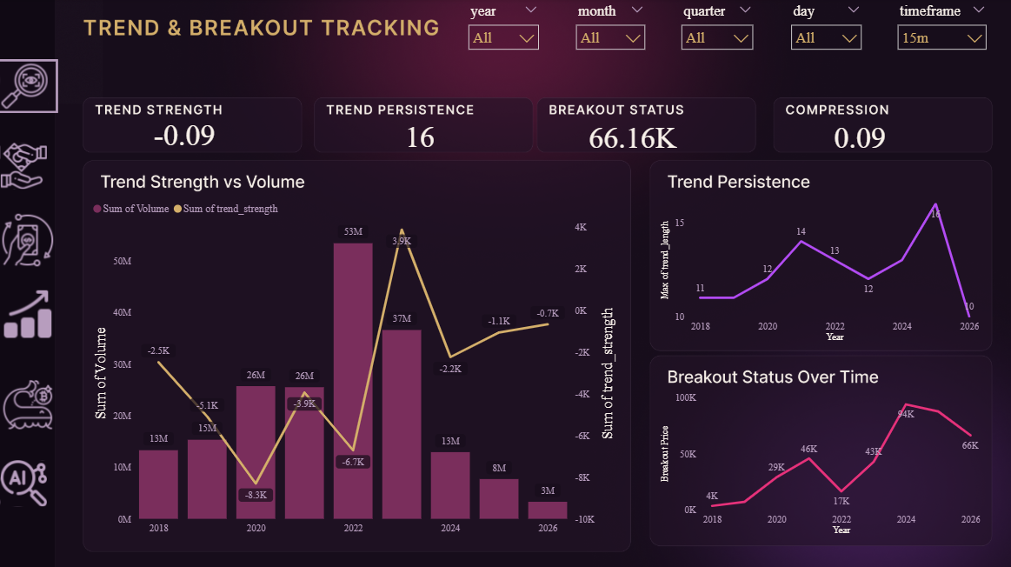
Project Wireframe :
Power BI Dashboard : Page 4- Trend & Breakout Tracking:
Trend & Breakout Tracking:
This dashboard follows how strongly Bitcoin's price trends are building or fading over time, helping users spot sustained runs, streak reversals, and breakout moments as they form.

Slide 16
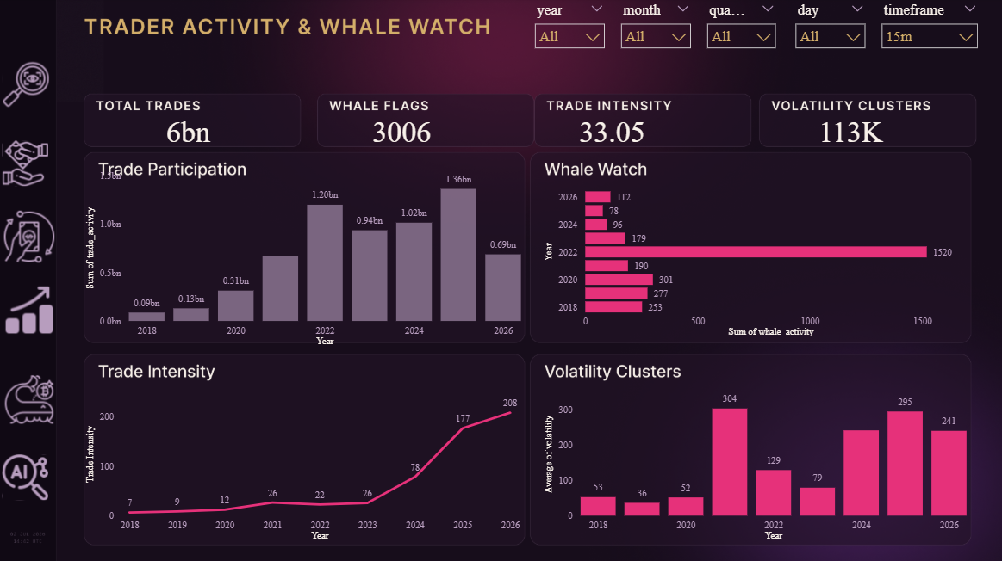
Project Wireframe :
Power BI Dashboard : Page 5- Trader Activity & Whale Watch:
Trader Activity & Whale Watch:
This dashboard surfaces how active traders are and where large players are moving the market, helping users spot participation trends and whale-driven volume before it shows up in price.

Slide 17
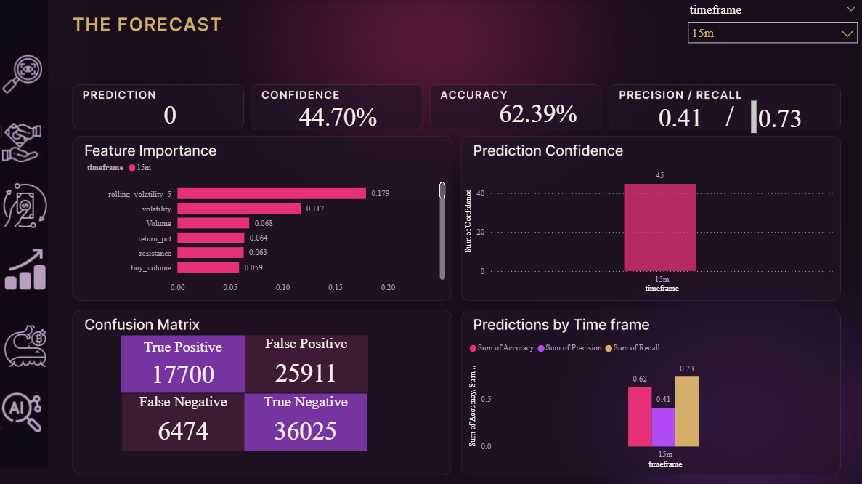
Project Wireframe :
Power BI Dashboard : Page 6 – The Forecast :
The Forecast:
This dashboard translates a machine learning model's predictions into a clear read on Bitcoin's next move, helping users gauge signal strength, confidence, and historical accuracy before acting on it.

Slide 18

Project Wireframe :
Figma Design:
The Design:
The dashboard's visual design was developed in Figma to establish a cohesive design system prior to implementation in Power BI. The interface follows a dark, editorial aesthetic that departs from conventional crypto/fintech dashboard styling (typically dark backgrounds paired with neon-green accents), instead using a warm, jewel-toned palette to give the project a distinct visual identity.

Slide 19



Project Team + Roles :
Yasmin Abdelhamid
Sama Mohamed
-Team Leader
-Medalion Architecture
-Machine Learning
-Microsoft Fabric
-Medalion Architecture
-Exploratory Data Analysis
-Documentation
Rewaa Mostafa
Samira Samir
-Power BI Dashboard Development
-Presentation Design
-Figma Design
-Documentation

Slide 20
Thank You !
Questions and Feedback are welcome

